Slide 1


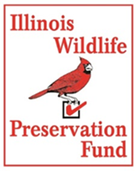
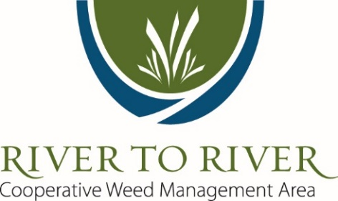

Invasive Plant Control Strategies and Techniques
spring 2017
Presented by the River to River Cooperative Weed Management Area
and
Supported by the Illinois Forestry Development Council and the Illinois Department of Natural Resources’ Wildlife Preservation Fund
Notes:
Welcome, and thank you for visiting the River to River CWMA’s presentation on invasive plant control strategies and techniques. This is one in a series of presentations that will be posted online at the River To River Cooperative Weed Management Area website at www.rtrcwma.org
Thanks to our sponsoring partner organizations, the Illinois Forestry Development Council and the Illinois Wildlife Preservation Fund.
This presentation is on the identification and ecology of priority invasive species in southernmost Illinois. Management of these species will be covered in a different presentation in this series.

Slide 2
Best Management Practices
Learn to identify invasive species
Avoid unintentional introduction/spread
Recognize/predict response of invasives to management
Respond early to new invasives (EDRR)
Minimize disturbance during management
Maintain desirable species
Avoid working in areas with invasive species when seeds or flowers are present if possible
If unavoidable, conduct activities with invasive species last, after uninfested areas.
Thoroughly remove all soil and plant material off of equipment after working in infested areas
Notes:
These are mostly common sense ideas for best management of invasive species.

Slide 3
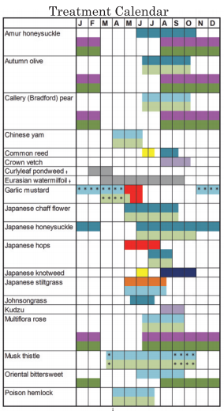
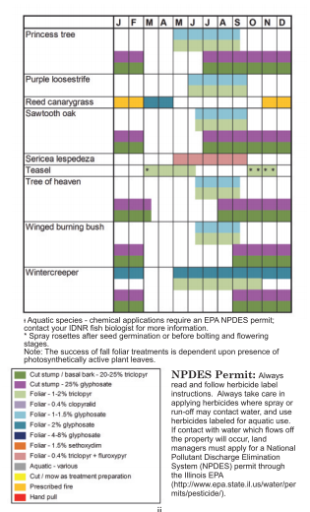
Using Plant Phenology
Notes:
Use of a plant phenology chart such as this one from the management guide at: http://www.fs.usda.gov/Internet/FSE_DOCUMENTS/stelprd3828074.pdf can help to better time treatments for the most effective treatments with the greatest impact on the target species.

Slide 4
Focus on small infestations and outliers and work inwards towards the center of infestation
Priority
Start at edge and work inwards
Notes:
The general idea here is that we should begin treatments of the outliers first, then push in on the edge of the core infestation, and finally, treat the core of the infestation. The logic is that we may not get to treat the entire population, and if we were to begin with the core, then the outliers may be allowed to set seed and spread to create a larger problem. Meanwhile, the core infestation has likely built up a seed bank that will require multiple years of treatment, so will still need to be treated in subsequent years.
On the other hand, with an outlier population, if it were to be controlled right away, the outlier population will not have had time to build up a seed bank. This will allow you to then treat from the edge of the core population towards the core and finally completely eradicate the population with follow-up treatments that would require less time and resources each year.

Slide 5
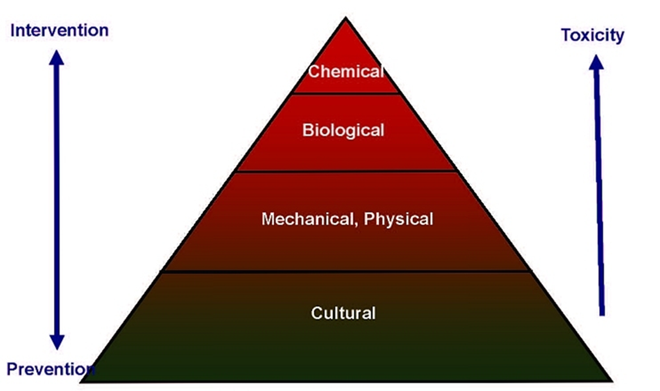
Integrated Pest Management
http://thevillagegardener.com/according-to-frank/components-of-an-integrated-pest-management-program/
Notes:
Integrated pest management (IPM) in natural areas is an ecosystem-based strategy that focuses on long-term prevention of invasive species or their damage through a combination of techniques such as cultural practices, mechanical controls, biological control, and minimizing the use of herbicides. Management actions are selected and applied in a manner that minimizes risks to human health, beneficial and non-target organisms, and the environment. Timing of management practices is often critical to an IPM strategy.

Slide 6
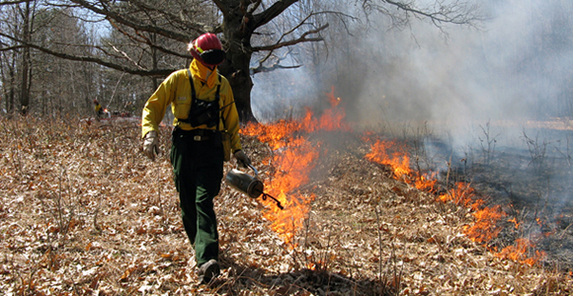
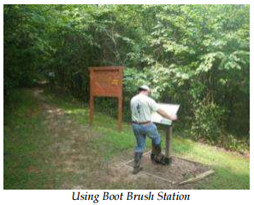
Cultural Controls
Prevention
Management and restoration for diversity and resiliency
Minimizing degrading disturbances
Prescribed fire (timing, additional control, and species dependent)
Survey and planning
Monitor results and adapt
https://www.nps.gov/fire/wildland-fire/learning-center/fire-in-depth/prescribed-fire.cfm
http://bugwoodcloud.org/mura/rtrcwma/assets/File/ISSTFinal_Annual_Report_2011.pdf
Notes:
Cultural controls are preventative measures, or actions that lead to a resistance to invasion. Whole systems are more resilient and resist invasion or reinvasion. Restoring native communities following control can improve long-term results. Prescribed fire, when timed appropriately, can control some species, or be a preparatory action to improve control through another treatment, such as herbicide application.
Having a plan, even if it needs later modifications, can improve results and lead to better management. Each site can have different characteristics that could mean different management techniques fail or succeed depending on differences between those characteristics.
Monitor your results. Don’t be afraid to change your tactics or strategy if you find your original ideas do not appear to be working.

Slide 7
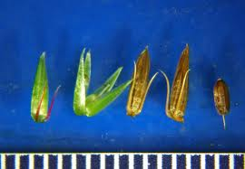
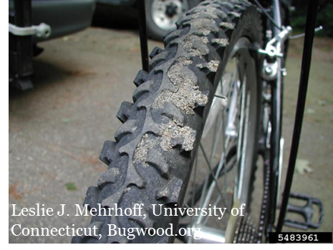
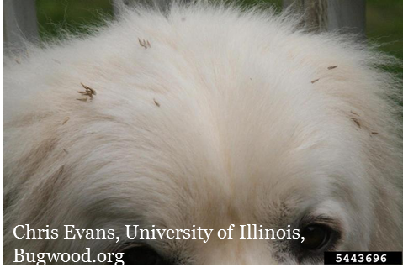
Cultural: Prevention
Minimize disturbance
Think about the timing
  Equipment work when ground is frozen, if possible
  Traveling through areas where seed is set; some species in particular
  Fire
Thoroughly clean all equipment, footwear, vehicles (and pets!) before moving to a new area
Copyright © 2012 by Travis Neal
Notes:
Prevention is the best option for management. It requires the least amount of time and resources in the long run when compared to controlling an infestation once it has become established.

Slide 8
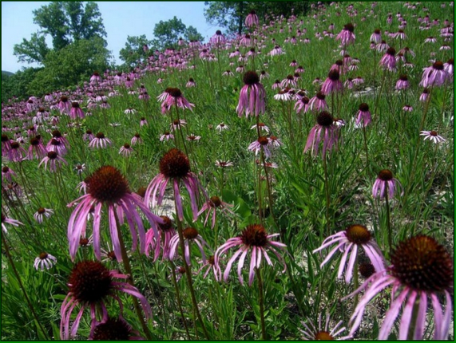
Cultural: Managing for resiliency
Resilient landscapes resist invasion through native competition and lack of heavy disturbance
Widening buffer zones
Fewer roads/trails
Timing and conditions of equipment use
Remember some disturbance can be a good thing that may be necessary to manage for resiliency
  Fire
  Forest Stand Improvement
  Canopy gaps
© Chris Benda
Notes:
This photo is from Cave Creek Glade Nature Preserve and is a good example of a resilient landscape that has been managed for diversity and appears to resist invasion from the surrounding disturbed areas. Some level of disturbance is necessary for maintaining most of our habitat types. Fire is a necessary disturbance that can lead to increases and decreases in different species and which species are favored will depend on the timing of the fire and the phenology of the species at the time of the fire. Generally, species that are actively growing at the time of the fire will decrease following fire at that time, while species that are dormant will likely increase following a fire at that time. Canopy gaps in the forest are also necessary for the germination of sun-loving species such as our native oak trees. However, these same canopy gaps can be a foothold for invasive plants to get a start and spread deeper into a forested habitat. Any disturbance that is introduced into a natural area should be properly timed or followed-up with additional treatments to reduce the abundance of invasive species in that area.

Slide 9
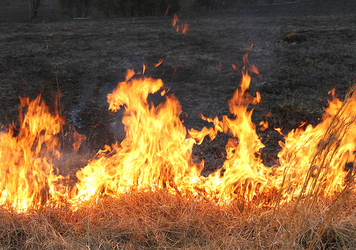
Cultural: Prescribed Fire
A (generally) beneficial disturbance
Cycles nutrients
Can create canopy gaps for herbaceous diversity and regeneration of oak-hickory
Necessary for some species to germinate (some good, some not)
Care needs to be taken to have the desired effects
John Flannery
What are some plant adaptations to fire?
What do we need to consider when using fire as part of an invasive plant control plan?
Notes:
As mentioned in the previous slide, fire effects on vegetation depend largely on the timing of the fire, as well as the adaptations of the species to fire or lack thereof. Fire is necessary for maintaining many of our natural communities, from forests and prairies to glades and even some wetland communities. We need to take care not to spread invasive species while conducting prescribed burns or conduct this practice without the expectation of follow-up treatments where/when they may be necessary for invasive plants we know will increase following a burn. Prescribed burns can also be a way to prepare a site for herbicide treatment, and several examples of different species that may be appropriate for this practice will be examined in greater detail to follow.

Slide 10
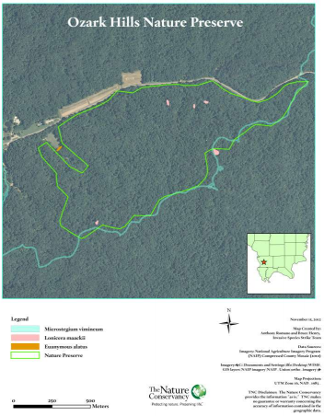
Cultural: Survey and Planning
What is the condition of the land?
What is the background/history?
Where are the invasive species?
What are the pathways/sources?
Where are the most intact natural communities?
What/where are the greatest threats to the ecology of the area?
What are realistic goals for the area, and what are the best methods for accomplishing those goals?
http://bugwoodcloud.org/mura/rtrcwma/assets/File/ISSTFinal_Annual_Report_2011.pdf
Notes:
Answering many of these questions will be a good place to start when considering a plan for your site. Soil types, natural communities, historic land use, corridors, species inventories, and more will direct your thinking about where potential trouble spots may be, and what the best strategy may be for managing invasive species on your site.

Slide 11
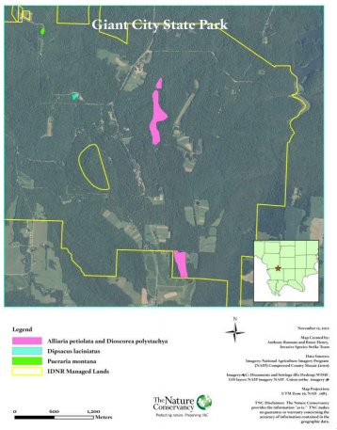
Cultural: Survey and Planning Continued
Resurvey and observe the results
Which results were satisfactory and which were not, and why?
Consider adjusting your plan: Adaptive management approach
http://bugwoodcloud.org/mura/rtrcwma/assets/File/ISSTFinal_Annual_Report_2011.pdf
Notes:
An adaptive management approach is a must in most cases. The first attempts at controlling and managing a site for invasive species may not be the approach that succeeds in the end. You may need to follow up treatments with plantings, change the timing of various practices, use different herbicides or rates of herbicides, try different combinations of fire, herbicides, and mechanical controls to lead to the greatest result.

Slide 12
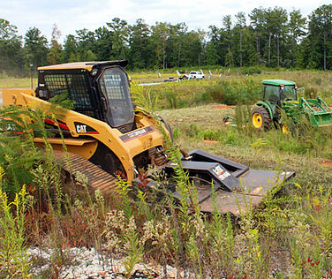
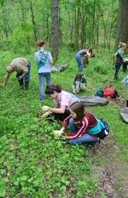
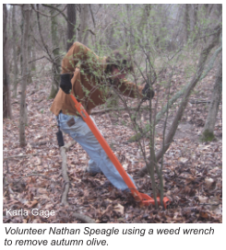
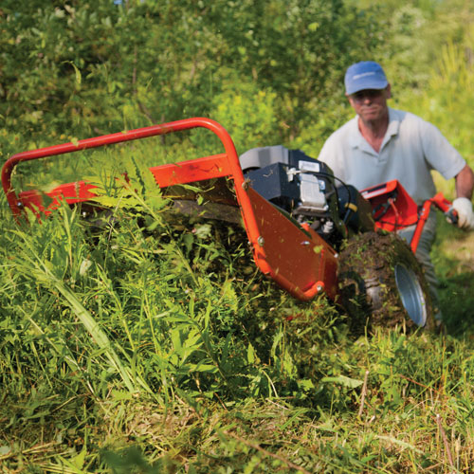
Mechanical / Physical Controls
Mowing
Hand-pulling
Weed wrench
Digging
String-trimmer
Forestry mowing
http://www.gabrushmowing.com/#!brushmowing/mainPage
https://www.nps.gov/cuva/learn/kidsyouth/exploring-park-ecosystems.htm
http://bugwoodcloud.org/mura/rtrcwma/assets/File/Management_SILinvasiveplants.pdf
http://blog.drpower.com/freeing-stuck-dr-brush-mower/
Notes:
Mechanical controls can be successful in managing some species, especially in reducing the population size and effects of many invasive plants. They can also be a preparatory action to minimize the use of subsequent herbicide treatments. Timing of mechanical controls like mowing or string trimming can be critical to controlling herbaceous plants.

Slide 13
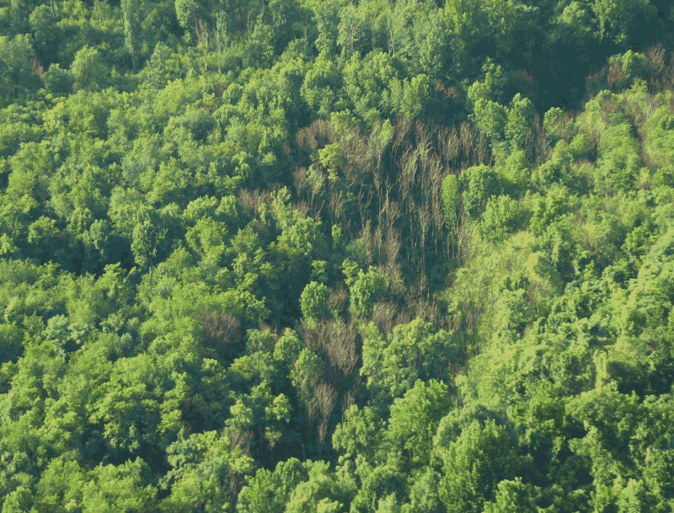
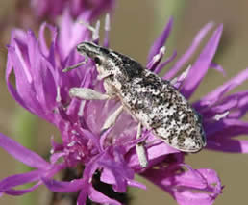
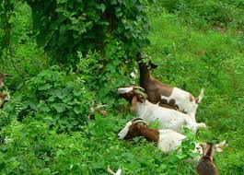
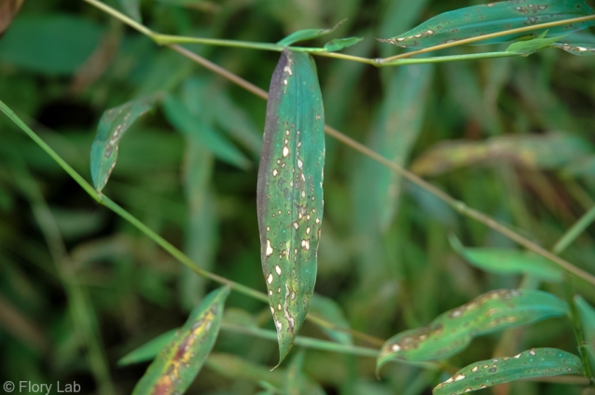
Biological Controls
Grazers
Natural enemies
  Diseases
  Herbivores
Penn State
http://invasives.wsu.edu/biological/cyphocleonusachates.htm
http://www.bbc.com/news/magazine-30583512
Flory Lab, http://www.florylab.com/photos/
Notes:
A knapweed root weevil, a currently used biocontrol insect on spotted knapweed (left)
Verticillium albo-atrum, or Ailanthus verticillium wilt results in the near complete death of tree-of-heaven and is being researched as a potential biocontrol (top right).
A fungal leaf blight on Microstegium could be a potential biocontrol, but more research is needed. This leaf blight can also infect corn so is not likely to be an authorized biocontrol any time soon (bottom right).
Finally, prescribed grazing can be a form of control on its own when timed properly, or when coupled with other means of control, such as a follow-up herbicide treatment of resprouts.

Slide 14
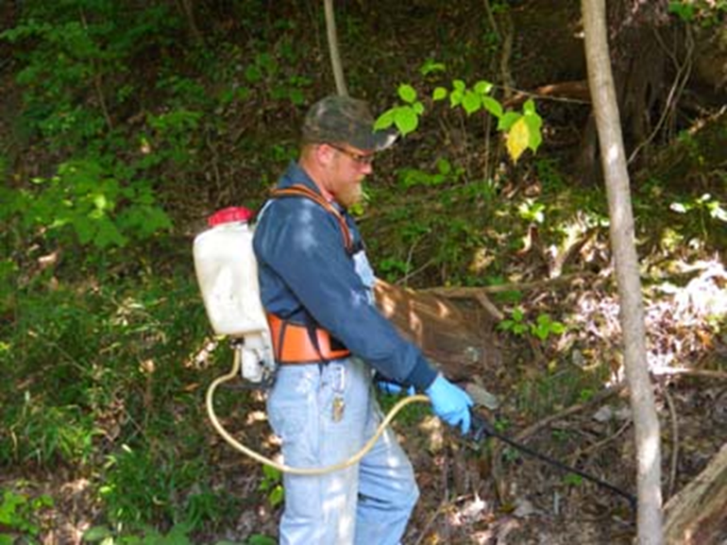
Using Chemical Controls Wisely
Use the least to effectively treat
Minimize area, e.g. hand-pull outliers near desirable plants
Minimize overspray
Reduce drift/volatilization
Specificity
Timing
Use the least toxic options

Slide 15
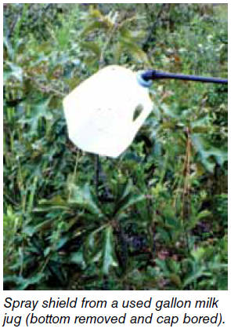
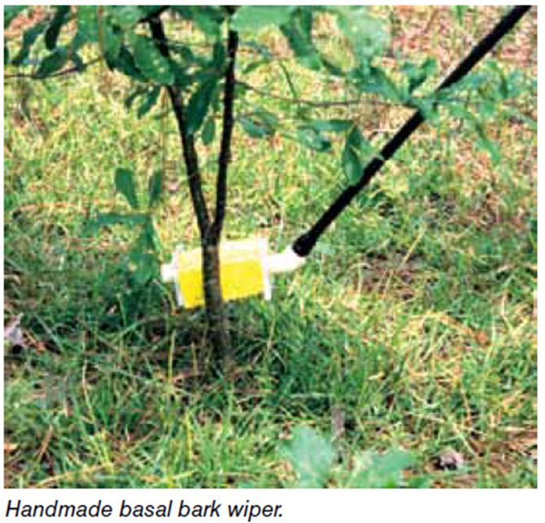
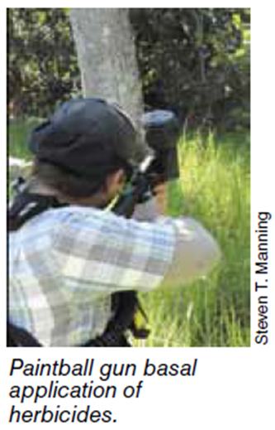
Chemical: Wise Use
What is the best method/technique for using the least amount of herbicide?
  Various techniques depending on target species and life stages
What are some ways to minimize overspray/drift/non-target impacts?
  Reducing pressure/increasing droplet size
  Shields / protective barriers
  Spray on less windy days
  Timing
  Technique
http://www.srs.fs.fed.us/pubs/gtr/gtr_srs131.pdf
Notes:
Using creative tools to minimize overspray and non-target impacts can be effective and fun!

Slide 16
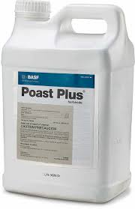
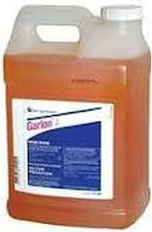
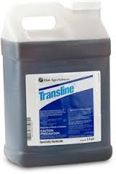
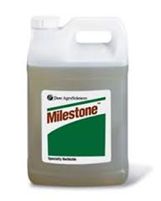
Herbicide Selectivity
Grass-specific
Broadleaf specific
More specific
  Transline (clopyralid) targets legumes and composites
  Milestone (aminopyralid) similar targets
The more intact we can leave the native community, the faster it will recover

Slide 17
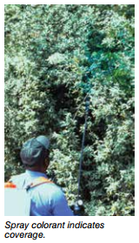
Foliar Spraying
Target individual plants or clumps
Typically low % solution (1-5%)
Timing – need actively growing vegetation
Can reduce non-target impacts when timing is considered for some species
Thoroughly wet all leaves to the point of run-off (but not beyond)
Take care to treat most leaves on a plant
Do not use foliar applications if rain is predicted within the next 24 hours (check label)
http://www.srs.fs.fed.us/pubs/gtr/gtr_srs131.pdf

Slide 18
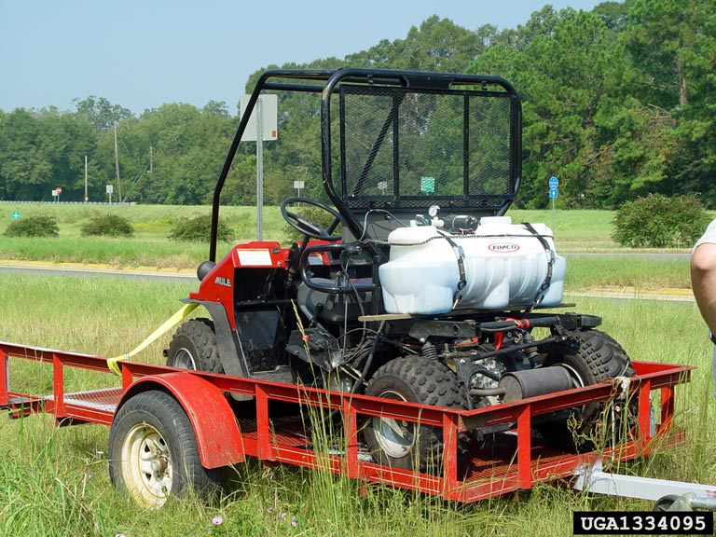
Notes:
A larger sprayer such as this electric powered pump sprayer, or higher powered gasoline engine powered pumps attached to skid sprayers will be more efficient for larger infestations, or where accessible by UTVs or 4WD trucks.

Slide 19
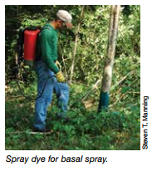
Cut Stump and Basal Bark
Very little non-target effects
Can be labor intensive
Could miss applications to smaller stems
Typically high % solution (15-50%)
Timing – Anytime, but spring (during leaf-out) is less effective
http://www.srs.fs.fed.us/pubs/gtr/gtr_srs131.pdf

Slide 20
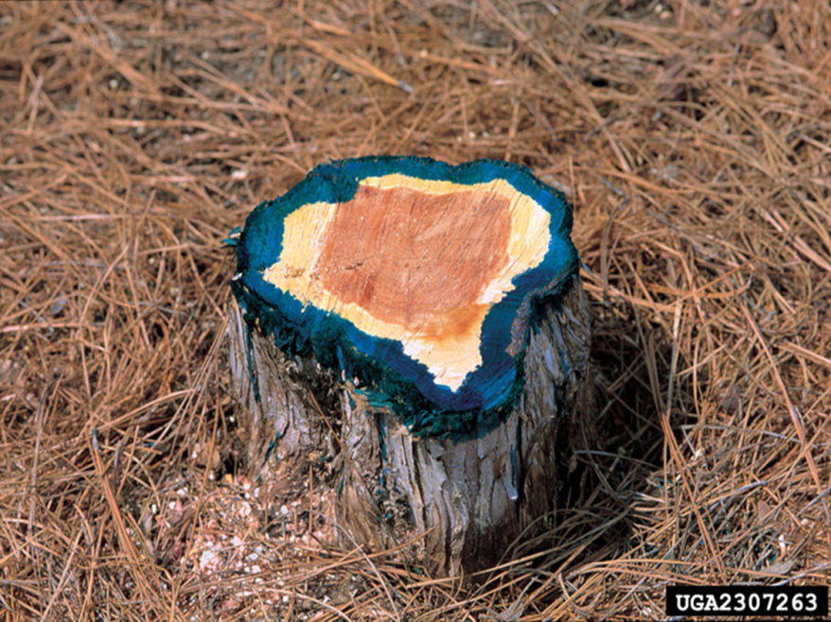
Cut Stump
After cutting down stem, immediately treat cut surface with herbicide.
For small stems (under 4” in diameter) treat entire surface heavily enough that the herbicide just starts running down the side of the stem
For larger stems only treat the outer 1.5” – 2”

Slide 21
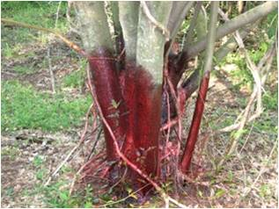
Basal Bark
Treat the entire circumference of the stem from ground-level to 12”-18” height with oil-based herbicide
If plant is multi-stemmed, then you must treat all stems
Do not use this method if the stems are coated in silt, such as after a flood event, as this will greatly reduce efficacy
Dow Agrosciences

Slide 22
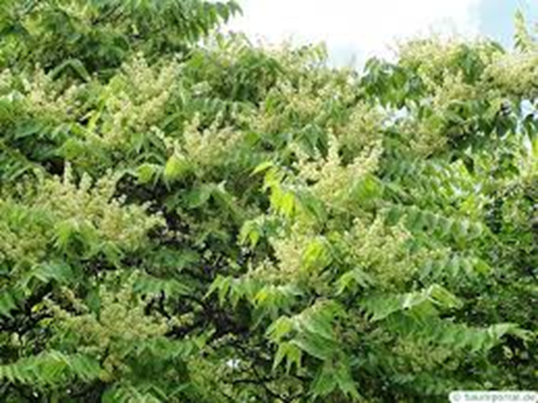

Tree-of-heaven (Ailanthus altissima)
Chemical:
  Foliar
  Basal bark:
  Cut Stump is not recommended, instead, for larger trees, girdle or frill the stem and apply herbicide directly into cut surface.
Mechanical
  Do not cut!
Cultural: Seedlings may be killed by prescribed fire, but top killing older plants will cause root suckering
Biological
Page 20 in Management…
Notes:
Chemical:
Foliar: Apply 1 to 3% v/v glyphosate in water or 1 to 2% v/v triclopyr in water during the growing season when plants are actively growing and before fall leaf color change.
Basal bark: Apply a triclopyr ester formulation at a 20% v/v rate, mixed with basal oil, to the lowest 1 5 inches of the stem.
For larger trees, girdle or frill the stem and apply herbicide directly into cut surface. Always read and follow the herbicide label before initiating treatment.
Mechanical: Repeated mowing of small plants may exhaust root systems, but larger plants should not be cut without immediately applying herbicide as this will cause root suckering and increase the infestation. Small plants can be pulled; larger plants or plants that are part of a larger root system (clonal growth) cannot be removed by pulling or digging.
Cultural: Seedlings may be killed by prescribed fire. Plants older than seedling stage should not be burned without treating with herbicide first; top killing plants will cause root suckering.

Slide 23
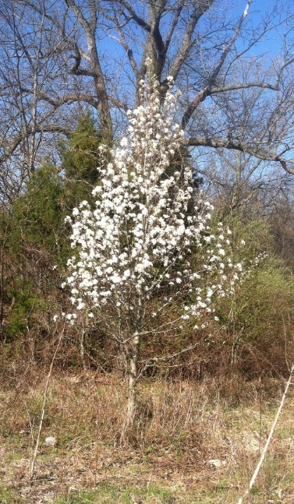
Callery (Bradford) Pear (Pyrus calleryana)
Chemical:
  Foliar
  Cut stem
  Basal bark
Mechanical
Cultural
  Prescribed fire may kill seedlings
Biological
Page 8 in Management…
Notes:
Foliar: Apply 2 to 4% v/v glyphosate in water or 1 to 2% v/v triclopyr in water.
Basal bark: Plants 4 inches in diameter or less - apply a triclopyr ester formulation at a 20 % v/v rate, mixed with basal oil, to the lowest 15 inches of the stem.
Cut stem: Apply glyphosate at a 25 to 50% v/v rate in water or triclopyr amine in water or ester in oil at a 20 to 25% v/v rate within 10 minutes of cutting.

Slide 24
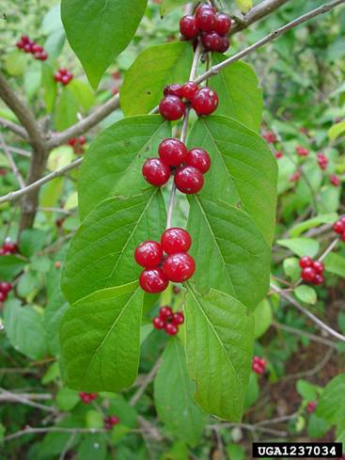
Amur Honeysuckle (Lonicera maackii)
Chemical:
  Foliar
  Basal bark
  Cut stem
Mechanical
  Root systems are shallow
Cultural
  Prescribed fire may kill seedlings
Biological
Page 7 in Management…
Notes:
Chemical:
Foliar: Plants less than 6 feet tall - apply 2 to 4% v/v glyphosate in water or 1 to 2% v/v triclopyr in water.
Basal bark: Plants 6 inches in diameter or less - apply a triclopyr ester formulation at a 20 to 30% v/v rate, mixed with basal oil, to the lowest 15 inches of the stem.
Cut stem: Apply glyphosate at a 25 to 50% v/v rate in water or triclopyr amine in water or ester in oil at a 20 to 25% v/v rate within 10 minutes of cutting.
Mechanical: Root systems are shallow so small individuals can be hand-pulled and larger plants can be pulled with weed wrench or other mechanical means.
Cultural: Prescribed fire may kill seedlings.

Slide 25
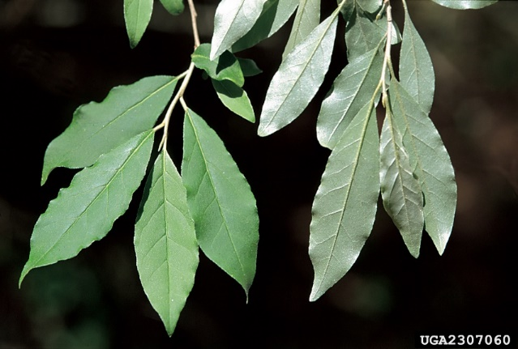
Autumn Olive (Elageagnus umbellata)
Chemical:
  Foliar
  Cut stem
  Basal bark
Mechanical
  Autumn olive root systems are deep.
Cultural
  Prescribed fire has little impact and is not recommended for autumn olive control
Biological
Page 8 in Management…
Notes:
Chemical:
Foliar: Plants less than 6 feet tall - apply 2 to 4% v/v glyphosate in water or 1 to 2% v/v triclopyr in water.
Basal bark: Plants 6 inches in diameter or less - apply a triclopyr ester formulation at a 20 to 30% v/v rate, mixed with basal oil, to the lowest 15 inches of the stem.
Cut stem: Apply glyphosate at a 25 to 50% v/v rate in water or triclopyr amine in water or ester in oil at a 20 to 25% v/v rate within 10 minutes of cutting.
Mechanical: Autumn olive root systems are deep. Heavy machinery may be required to remove large plants.
Cultural: Prescribed fire has little impact and is not recommended for autumn olive control.

Slide 26
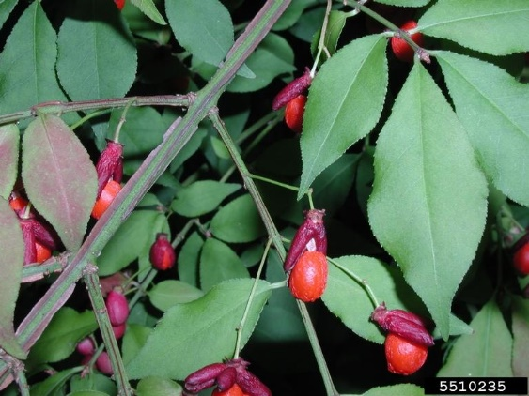
Winged burning bush (Euonymus alatus)
Chemical:
  Foliar
  Basal bark
  Cut stem
Mechanical
  Plants can be pulled from the ground when the soil is moist
Cultural
  Prescribed fire may kill seedlings but generally not large plants.
Page 21 in Management…
Notes:
Chemical:
Foliar: Apply 2 to 4% v/v glyphosate.
Basal bark: Plants 4 inches in diameter or less - apply a triclopyr ester formulation at a 20 to 30% v/v rate, mixed with a basal oil, to the lowest 15 inches of the stem.
Cut stem: Apply glyphosate at a 25 to 50% v/v rate in water or triclopyr amine in water or ester in oil at a 20 to 25% v/v rate within 10 minutes of cutting. Always read and follow the herbicide label before initiating treatment.
Mechanical: plants can be pulled from the ground when the soil is moist.
Cultural: Prescribed fire may kill seedlings but generally not large plants.

Slide 27
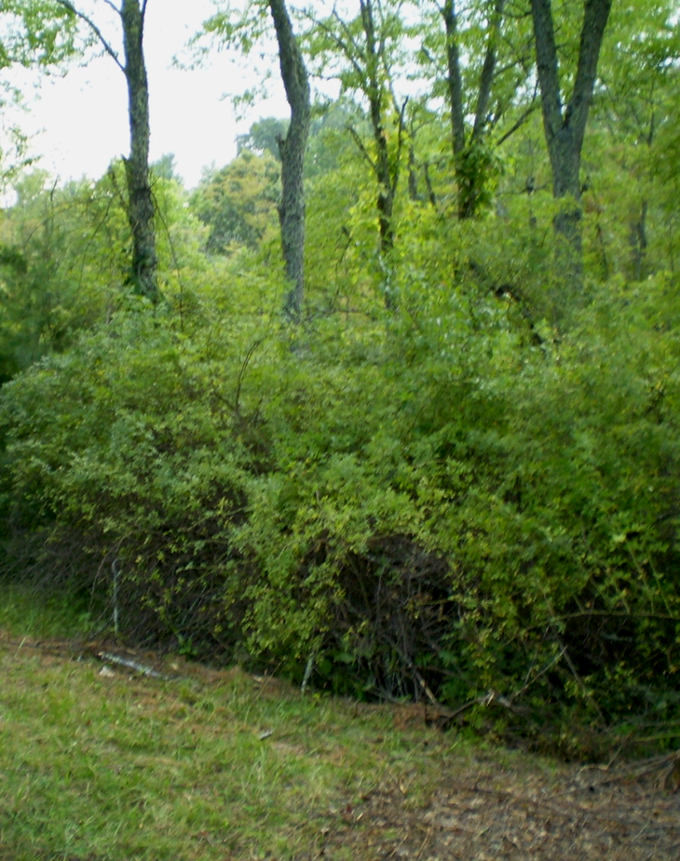

Multiflora Rose (Rosa multiflora)
Chemical:
  Foliar
  Basal bark
  Cut stem
Mechanical
  Mechanical removal may be impractical
Cultural:
  Prescribed fire may kill seedlings, but older plants will likely resprout
Page 15 in Management…
Notes:
Chemical: Foliar:
Apply 2 to 4% v/v glyphosate in water or 1 to 2% v/v triclopyr in water.
Basal bark: apply a triclopyr ester formulation at a 20% v/v rate, mixed with basal oil, to the lowest 1 5 inches of the stem.
Cut stem: Apply glyphosate at a 25 to 50% v/v rate in water or triclopyr amine in water or ester in oil at a 20 to 25% v/v rate within 10 minutes of cutting. Always read and follow the herbicide label before initiating treatment.
Mechanical: Mechanical removal may be impractical due to difficulty in removing plants without breaking the roots, as well as the difficulty of dealing with thorns.
Cultural: Prescribed fire may kill seedlings, but older plants will likely resprout from roots. Prescribed fire may allow easier treatment of plants with herbicides by removing thorny overgrowth.

Slide 28
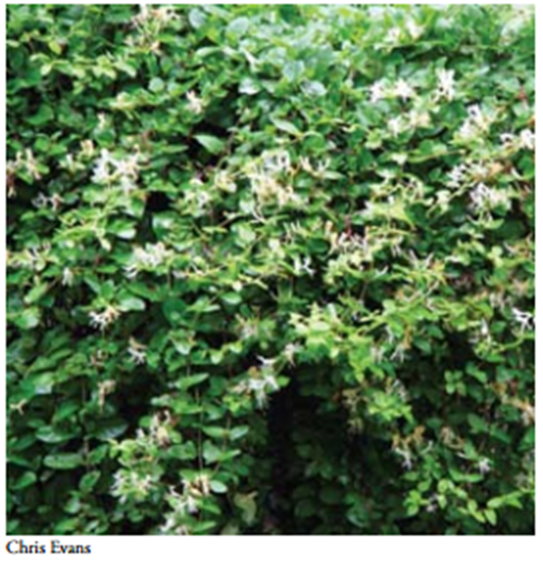
Japanese honeysuckle (Lonicera japonica)
Chemical
  Foliar
  Basal bark
  Cut stem
Mechanical
  Root systems may be removed by pulling or digging, but removal of the entire root system is difficult and follow up treatments may be needed.
Cultural
  Spring burns can kill young plants and remove dense growth to facilitate herbicide treatment
Biological
Page 11 in Management…
Notes:
Chemical: Foliar:
Apply 1.5 to 2% glyphosate v/v in water to foliage. The best time to make this application to reduce non-target damage of native plants is during the fall after the first frost, when native plants have lost their leaves and Japanese honeysuckle is still green and healthy. Apply on a warm day when temperatures are close to 60°F.
Alternatively, 2% triclopyr can be applied to foliage in summer through late fall.
Basal bark / cut stem: The thick stems of large woody vines can be treated in the same way as other woody species, with 20 to 25% glyphosate (cut stem) or 10 to 20% triclopyr (cut stem or basal bark).
Always read and follow the herbicide label before initiating treatment.
Mechanical: Root systems may be removed by pulling or digging, but removal of the entire root system is difficult and follow up treatments may be needed.
Cultural: Spring burns can kill young plants and remove dense growth to facilitate easy treatment with herbicides. Vines can also act as ladder fuels for crown fires in tree canopies

Slide 29
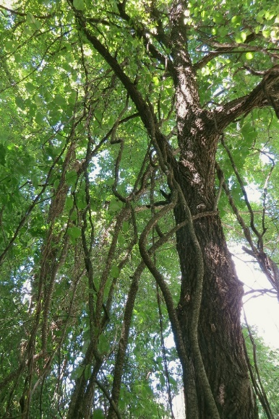

Oriental Bittersweet (Celastrus orbiculatus)
Chemical:
  Foliar
  Basal bark
  Cut stem
    Can be effective, but not recommended
Mechanical
  Seedlings can be pulled by hand, but may lead to resprouting
Cultural
  Prescribed fire may kill seedlings but will top-kill larger plants, which will stimulate root suckering. Fire without integrated treatment with herbicides may increase stem density 2 to 3 times.
Page 15 in Management…
Notes:
Chemical:
Foliar: Apply 2% v/v glyphosate in water or 1 to 3 % v/v triclopyr in water to healthy foliage.
Basal bark: Apply 20 to 30% v/v solution of triclopyr ester in a basal oil.
Cut stem: Cutting the stem will stimulate root suckering (sprouting), increasing stem density. Cutting should not be done without applying herbicide, but herbicide may not translocate to the end of the root system. A 10 to 20% solution of triclopyr or a 20 to 25% solution of glyphosate can be used with follow up monitoring to ensure herbicide translocation. Always read and follow the herbicide label before initiating treatment.
Mechanical: Seedlings may be pulled by hand, but the root is difficult to remove completely, which will lead to resprouting.
Cultural: Prescribed fire may kill seedlings but will top-kill larger plants, which will stimulate root suckering. Fire without integrated treatment with herbicides may increase stem density 2 to 3 times.

Slide 30
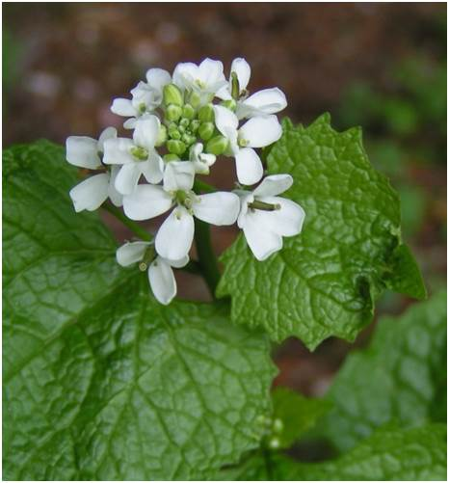
Garlic mustard (Alliaria petiolata)
Chemical
  Foliar
Mechanical
  Bolting plants easily removed by hand pulling
  Pulled plants that have begun to flower must be bagged and taken off site, since seeds may still form after pulling
  Cutting flowering plants at ground level will reduce seed production
Cultural
  Prescribed fire in late spring kills seedlings and reduces rosettes.
  Once leaf litter is removed by fire, there may be a flush of new seedling emergence
  Following up with herbicide treatment may exhaust the seedbank faster
Biological
Page 10 in Management…
Notes:
Chemical:
Foliar: Apply 1 to 3% glyphosate v/v mixed with water to plants in rosette or bolting stage. Glyphosate may not prevent seed production once seeds have begun to form. Alternatively, a 1.5% solution of triclopyr may be used in the fall or spring on rosette s or during bolting or flowering stage. Treating flowering plants with triclopyr amine (Garlon 3A) may prevent viable seeds from forming. Once seeds are mature, they are easily spread, and entering patches of garlic mustard is not recommended. Always read and follow the herbicide label before initiating treatment.
Mechanical: Once plants have started to bolt, they are easily removed by hand pulling. Pulled plants that have begun to flower must be bagged and taken off site, since seeds may still form after pulling. Cutting flowering plants at ground level will reduce the amount of seed produced.
Cultural: Prescribed fire in late spring may kill seedlings and reduce the number of rosettes. However, once leaf litter is removed by fire, there may be a flush of new seedling emergence. Following up with herbicide treatment may exhaust the seedbank faster.

Slide 31
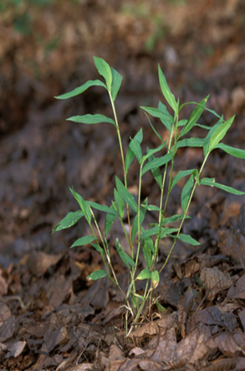

Japanese stiltgrass (Microstegium vimineum)
Chemical
  Foliar
Mechanical
  Plants are easy to pull.
  Mowing or weed whipping is effective if done late in the season but before plants flower
Cultural
  Following prescribed fire, there will be a flush of germination from the seedbank
  Follow up treatment with herbicides or mechanical methods are necessary to prevent the development of a more dense infestation
  Integrated methods, using prescribed fire and herbicides, may lessen the duration of the infestation
Biological
Page 13 in Management…
Notes:
Chemical:
Foliar: Apply a grass-specific herbicide, such as sethoxydim, at a 1.5% rate in mid- to late summer until the time that seeds begin to mature on the plant. Once seed have begun to mature, entry into infestations is not recommended.
Alternatively, apply glyphosate at a 1 to 1.5% v/v in water. Glyphosate is non-selective and will kill all plants contacted but is available in aquatic safe formulations, Always read and follow the herbicide label before initiating treatment.
Mechanical: Stiltgrass roots are very shallow, and plants are easy to pull. Mowing or weed whipping is an effective treatment if done late in the season but before plants flower.
Cultural: Following prescribed fire, there will be a flush of germination from the seedbank. Follow up treatment with herbicides or mechanical methods are necessary to prevent the development of a more dense infestation. Integrated methods, using prescribed fire and herbicides, may lessen the duration of the infestation.

Slide 32
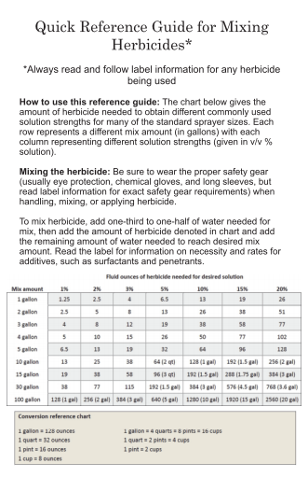
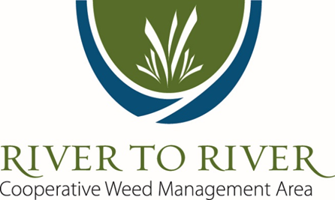
More Information
Gage, K. 2011. Management of Invasive Plants of Southern Illinois http://bugwoodcloud.org/mura/rtrcwma/assets/File/Management_SILinvasiveplants.pdf
Miller, J.H., S.T. Manning, & S.F. Enloe. A Management Guide for Invasive Plants in Southern Forests http://www.srs.fs.fed.us/pubs/gtr/gtr_srs131.pdf
Osborne, T. and Steffen, B. 2009. Invasive Plants of Southern Illinois http://bugwoodcloud.org/mura/rtrcwma/assets/File/SILinvasiveplants.pdf
http://www.rtrcwma.org
Notes:
Thanks for checking out this presentation of the River to River Cooperative Weed Management Area! Be sure to check out the other four presentations in this series and see our website at www.rtrcwma.org for more resources and information such as these guides to the identification and management of invasive plants in Southern Illinois.

